Slide 1
Going Faster
Long Days

Slide 2
Agenda
Long Days vs Short Days
How to Spot the Big One
Preparation and Planning
Managing the Flight
Flight Analysis

Slide 3
Long Days, Long Distances
Big Days in Club Flying
  Deliberate Big Days when trying a long flight
  Accidental Big Days, when it just gets slow
    Same features- mostly at the second half!
Big Days in Competition Flying
  Long Distances sometimes set to stretch the pilot
    Very rare that this happens deliberately, but…
  Do Happen by cockup- hence difficult to prepare
    Often get an inkling before the start
    Plan and change gear mentally
    BUT: don’t use concern as an excuse to start too early!

Slide 4
Mental Preparation for the Big One
What is “Big”?
  When you stretch your Ambition, further than have gone before
  Big Day in 1986 for me: 500Km. Now…?
What is Your “Big Day”?
  When you plan to use all the day…
  Set About Doing the Impossible…
Rule 1: Imagine Doing the “Impossible”
  In 1986: 500:- difficult, 750:- impossible, 1000:- ?mad?
  Now: 500:- good day, 750:- fine flight, 1000:- entirely do-able, 1250!
Rule 2: Get Prepared to do the “Impossible”
  Have your fantasy tasks ready, no canteen task setting
  Be there early, get ready swiftly, no trailer rack banter
  Be focussed, be ruthless, you go no-where when on the ground!

Slide 5
Physical Preparation
Tasks: Work Out your Fantasy Tasks
  Tasks for the Weather, Distance, Airspace
    East/West, North/South, Southwest, Through the Mch/Bhm Slot
  Always find way to improve, to tweak the tasks
Spot the Weather
  General Situation: Ridge behind Cold Front
  Cloud Amounts: review the sat pics over task area
  Use RASP, then dig deeper
Everything Must be Ready:
  Time Off Work: chat up the boss, get the team to cover
  Batteries charged, drinks, food, headache pills, pee bags
  Barrels filled and ready, rigging crew, even rig night before!
Get Launched!
  I’ve waited 20 minutes on 750 day for the tuggy to finish his breakfast

Slide 6
On the Flight
Critical Phases of the Flight
  Starting: get going well, racing not surviving
  Finishing: keep high, out of trouble but keep pushing
  No Screw-ups! One bad low-point can scupper you
Starting is Critical: sets the mind state for the flight
  Have to be positive, but stay in the air: my record 10:25 land-out
  Take the high tow, remember 1000m rule; start high, finish high
  Cant afford to stop in everything; weak thermals, heavy glider
Transition: Low, Slow, Straight to First Big Climb
  Go from creeping along slow and cautious
  Base goes up, thermals start to spread… Spot the Danger!
End of Flight Nerves: Stay High Stay Safe- but…
  Shut off tends to happen from the ground up; don’t expect low saves
  BUT Too “safe” is dangerous, slow, late, land-out!

Slide 7
The Meat of the Flight
Key to Success: Pure Speed
  To Go Far, Faster is Safer
  Must make the most of the best part of the day
  Any fumble is a big hit- especially at Bala or Keilder
Pure Speed for the whole flight
  No good doing a great sprint, then parking at 500ft
  Don’t burn out- you may be flying for 8-10 hours
  Be Sensitive to Changes of Pace: no day is non-stop good!
Manage Your Body: keep sharp!
  Keep Drinking- and have enough for 10 hours flying
  Eat, little and often: Slow Release Food

Slide 8
780Km in ASW 28
Classic Early Start
  Just go and hope; not high, but plenty of clouds
  OMG- where is that thermal? Good old scrabble
Classic Transition
  Long Slow Glides, unable to contact decent climb
  Pushed out to clouds with airfield and get away
Then Get to Business
  Working hard to get runs up, climbs strong
  Properly good: 4.6kt averages, decent glides
The Tricky Bit
  Round the last TP- sea air, gaps, getting late…
  Nice last climb, helped by the wind, good glide home

Slide 9
Conclusions
Planning and Preparation
  Believe in the impossible; think it through
  Get your tasks and kit ready for early start
Take Calculated Risks to get going
  It is likely to be 20min from launch to first thermal
Never Forget: you are in a RACE
  You are racing the weather and day, not other pilots
Keep you head in the end
  Keep going, keep positive, keep high
  Choose the right time to lighten the glider- not too early!

Slide 10
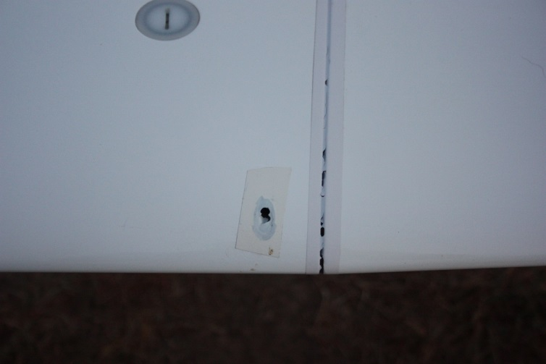
Showery Days
Variety of Showery Days
  Occasional, Dispersed Showers
    Can see from a distance, drive round or bounce through if light
  Squalls and Line Features
    Great if you go along them- not so good crossing them!
  Big Cells and Storms
    Very easy to spot, can sometimes go round: RESPECT
Approach to Showers
  Showers can be properly dangerous, even in UK
    Precipitation = collapsing vapour column: SINK
    You Cant See; coming down quick towards a field you cant see
    Turbulence and Lightening: very unlucky to get you but: SCARY
  Continental Storms, SA, Texas: don’t mess with them
    Can get very good lift near leading edges
    Can get 70Kt gust fronts, outflows, shear, lightening

Slide 11
How to Approach Showery Days
Get Going Early
  Early, pre-showers can be great conditions
  Down Side, you might lose a few minutes
  Up Side; you get round before the showers all join up!
Manage your Altitude
  Learn where they Work: black bits, in the clear, in rain!
  Get High near the cells so you have options if it goes wrong
  Route round and past them, choose the lines you can see through
  In the Rain, GO SLOW, turn the audio down, put the flaps down…
Just Don’t:
  Go through where you cant see the way out
  Mess with gust fronts, hail, squall lines
  If in doubt, land well clear and fight another day

