Slide 1
Going Faster
Straight Line Flying

Slide 2
Agenda
Technique: Flying Straight
  Three Bands of Planning
Straight and Slow or Fast Saw-tooth
  Example through Final Glide
Flight Analysis
  6th April

Slide 3
Three Levels of Action
The Here and Now
  Respond to the air that you are in
  Hit and Leave the cloud just right
  Current speed and Position
Tactical Planning
  Routing within your Range of Sight
  Stepping Stones and Street Selection
Whole Flight
  Competition Situational Awareness
  Altitude around Turn Points
  Getting Onto Final Glide

Slide 4
Here and Now
Approaching Clouds
  Keep the speed on, attitude flat
  Go for the best bit, deepest development, blackest bottom
Under the Cloud
  Seek every bit of variation of colour
  Learn what happens when you hit them
  Be aware of sun and wind direction
Leaving Clouds
  Speed on before you leave the lift!

Slide 5
What do You Do
An Exercise- Groups of 3-6
  What are you thinking in the glide
  What should you be thinking in the glide
The most important thing:
  In the climb- where are you going next
  In the glide- where will you climb next
Cockpit Work Rate
  Work hard when you can make a difference
  Take a moment when you can
  ALWAYS KEEP THINKING AND PLANNING

Slide 6
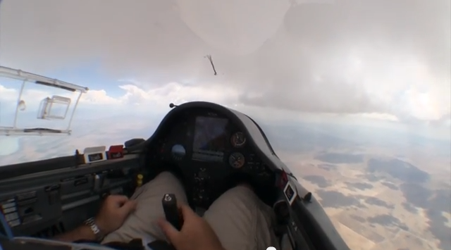
What you can see at base

Slide 7
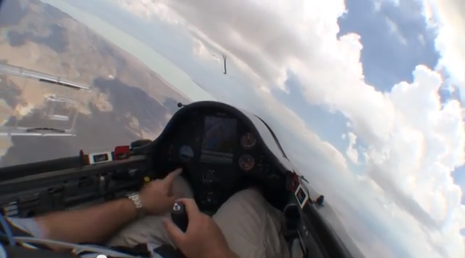
What you can see on the way up

Slide 8
Route Selection
Keep Up the Momentum
  Easy to keep going if you go too slow!
  Use the calculator- speed in the straight…
Minimise Sink between Climbs
  Sample more thermals
  Reduce height gain needed
  Trade-off against distance across the ground!
Sky Watching: who hasn’t!
  When watching Top Gear…

Slide 9
Slower and Straight, Faster and Climb?
An Example: 15m Nats Day 4
  Straight and Slow vs Fast Saw tooth
  Final Glide- he who starts first?
Conclusions:
  A bit slower lead to fewer stronger climbs
  Did a bit better in the really good weather
  Did a LOT better when it got a bit worse!
  Final glide:
    10: You cant beat a good climb at the right time
    M2: If you have enough height, keep going!
    G9: Averted a disaster but lost some time by keeping going

Slide 10
After the Break
Flight Analysis

Slide 11
Conclusions
Extending the glide isn’t always optimal
  McCready works! If your next thermal is strong, fly faster
Stretching the glides multiplies positive factors
  Going further means you sample more thermals
  Push through moderate ones, stop in the best ones
  Reduces the risk of getting low if you miss just one
Achieving is more difficult than Wishing!
  Determination to not turn your back on track
  Observer carefully what is working any one day
  Remember what worked well and do it again
  Keep up the Work Rate in the glide;

Slide 12
Practical Tips
Select from below the things you can improve
  Keep speed on until you hit the lift
  Don’t go round just because someone else is turning
  Get the speed on before hitting sink
  Work Clouds in a straight line- micro routing
  Work routes between clouds- tactical routing

