Slide 1
Competitions
Area Tasks

Slide 2
Planning, Flying, Surviving AATs
What Is an AAT?
Rules: Fundamentals of Scoring
Rules: What that means In Flight
Ground Preparation
Focus in the Air
Tactical Exceptions that Prove the Rule

Slide 3
Definition of a Racing Task
The Minimal Use of the Soaring Day to assure Distribution of Points and BarBQ Tickets
The way to get the Most Number pilots to do the Same Thing yet still declare a Winner

Slide 4
Definition of a Turning Point
That part of the sky that you would never visit under any other circumstances

Slide 5
Assigned Area Task
Why do we Have AATs?
  Reduce Gaggles, Add Variety
  Fit with the other scoring tasks
An AAT is a racing task around Areas
  Not a distance task! It’s a race.
You can choose where to turn within each Area
  Your Distance is scored from the best point in each
You should keep going for the Task Time
  If you fly for less time, your speed is Distance/Task Time
Fastest Flight Wins!

Slide 6
The Best Use of AATs
A Uniform Day
  Doesn’t have to be great, just predictable
  Should not have a big change event during the day
Don’t quite know how far you can go?
  Might get pretty good, or really excellent
  Pilot can adjust and avoid Task Setter embarrassment
Time and Distance should allow Options
  Avoid running out of space or just doing minimum distance!
Allow Freedom for Pilot Creativity
  Allow you to navigate to make most of the conditions
  Not blocked in by airspace, geography or weather

Slide 7
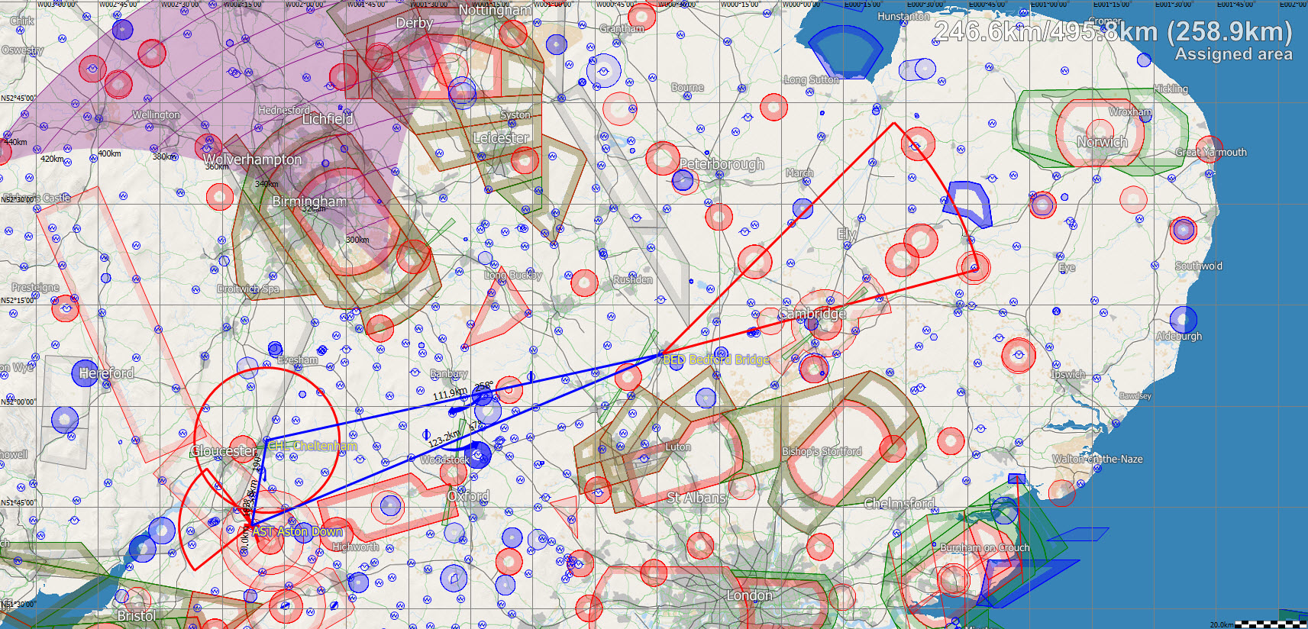
Extended OR with Adjustment

Slide 8
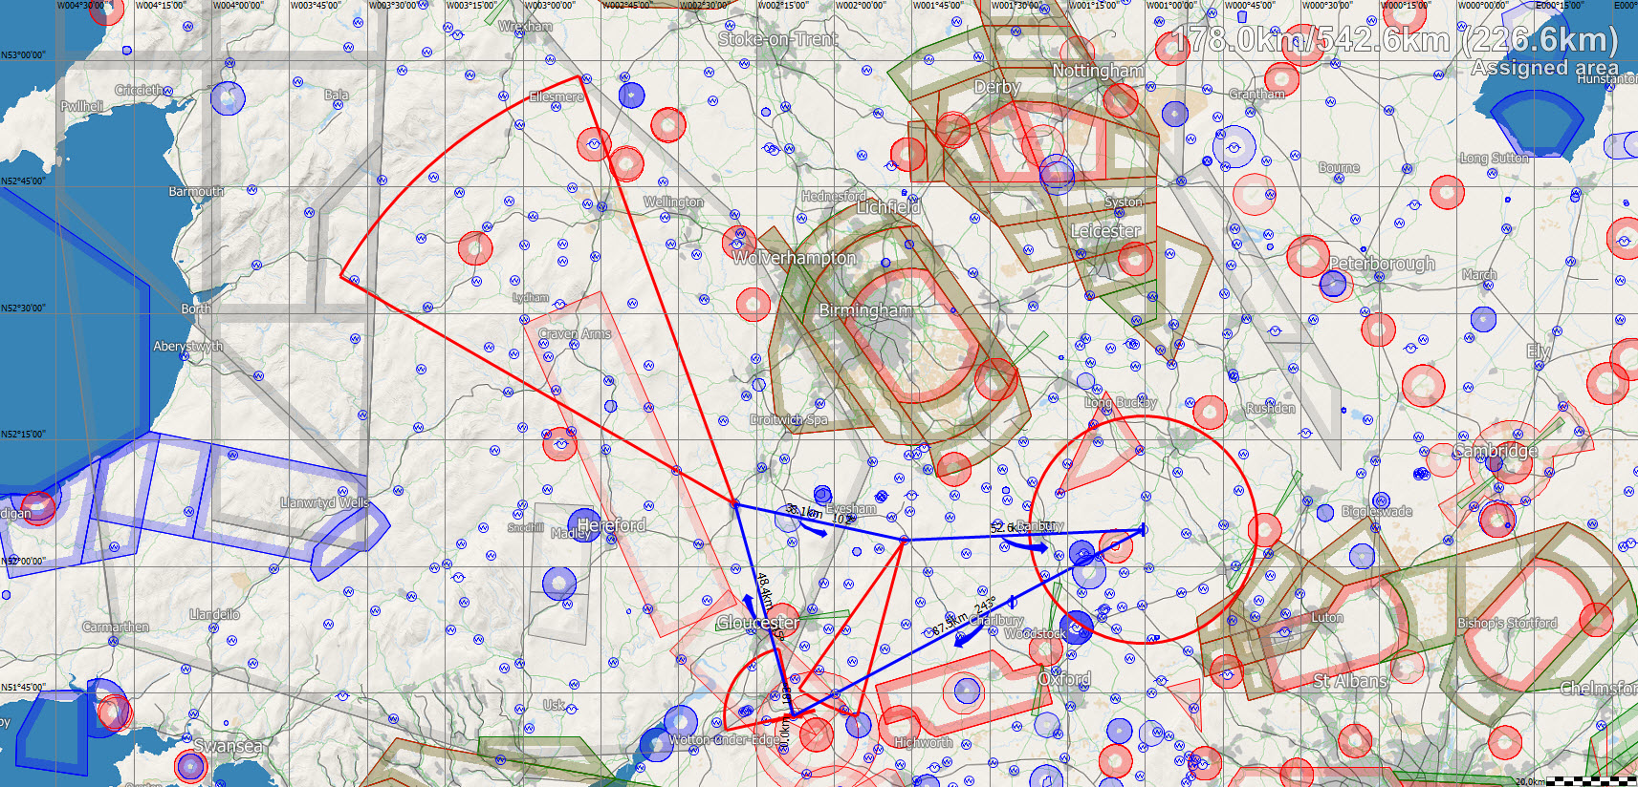
Round the Corner

Slide 9
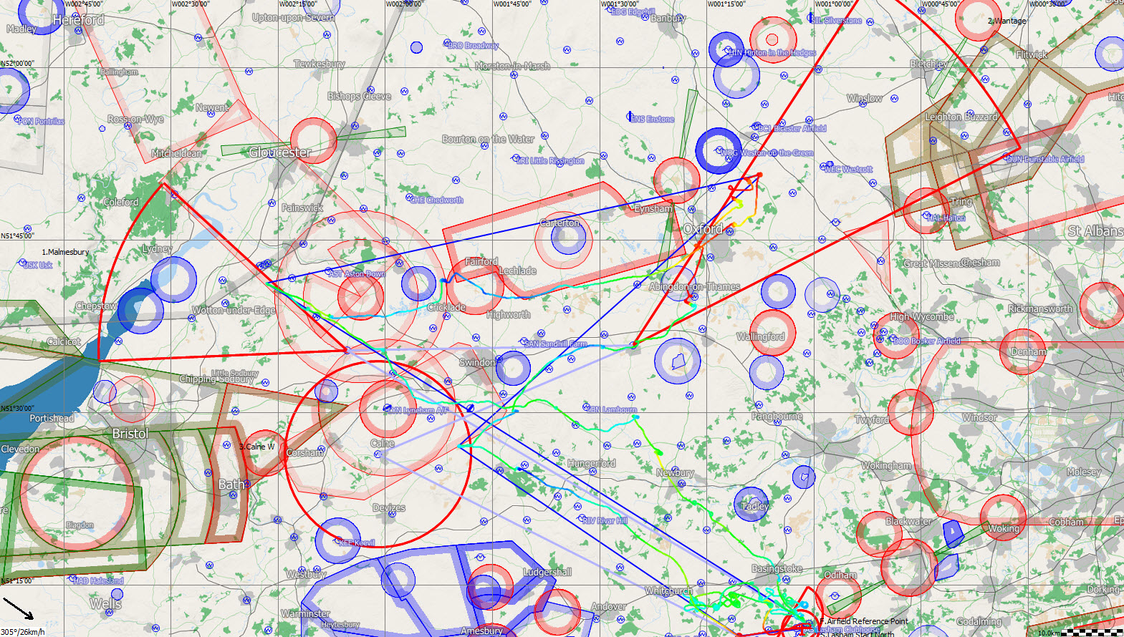
The very worst task I have ever flown

Slide 10
Side Bar: Competition Scoring
Step 1: Winners Score for the Day = 1000pts
  Or devalued by Number Past Y (Too flukey?)
  Or devalued by Points Per Km (Not enough distance)
  Or devalued by Task Time (too short to be fair)
Step 2: Winner gets the Day Points
  The points are divided between Speed and Distance
  More Finishers = More Speed Points
Step 3: Pilots get a proportion of Speed and Distance points
  If you finish > 2/3 the winners speed you get speed points
  Everyone get Distance Points, in proportion to winner’s distance

Slide 11
What Is Y?
A proportion of the task to signify a fair contest:
  40% of Distance or 30kph within limits

Slide 12
Find Max Points: Devaluation
By Pilots Past Y:
Distance, 5Pts/Km
Time 400Pts/Hour:

Slide 13
Split of Speed vs Distance
You get Speed Points for > 2/3 Winners Speed
  0 at 2/3, rising to 100% -
You get Distance Points in proportion to Winner
  Finishers get same points

Slide 14
Rules of AAT
Td: Nominated time for the task
Sh: Your speed is calculated using the longer of Td or your flight time
Vh: Fastest Finisher (adjusted for Task Time)
Dmax: Greatest Marking Distance
  may not be the winner! A really slow, long flight distorts things
Ps: Speed Points in proportion to your speed
  Zero if 2/3 Winner Speed or less
Pd: Distance points in proportion to Dmax
  Finishers: Get Winner Dist Points (if more than 2/3 Dmax)
  Short finishers: In proportion 2/3 Dmax
  Non-Finishers: Winner’s Dist Points in proportion to Dmax

Slide 15
What does that mean?
This is a Speed task- you have to race
You must get back if you possibly can
  No finish, no speed; distance points only
  Distance Points at least 33%, up to 100% if no finishers
Use all the time you can!
  If you come in under time your speed is reduced
NEVER give up going further
  Every Km counts in your favour, even after time runs out
Its ALWAYS better to get back
  Almost every finisher gets more points than any land-out

Slide 16
What do you Do!
Prepare on the Ground
  Set the task areas and time, Draw the Map
  Make an Initial Plan: long first leg…
Rule 1 Fly the Glider!!
  Don’t get distracted by all the details
Rule 2 Be Flexible
  Turn when it feels right: If its going well, keep going!
  Ideally at the top of a climb, making a sharp angle
Rule 3 Monitor your Time
  Perfect if the time runs out during the final glide

Slide 17
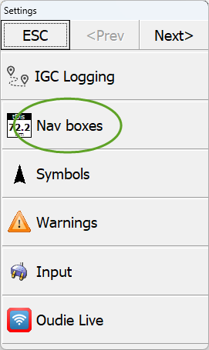
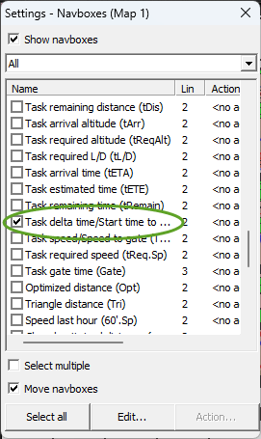
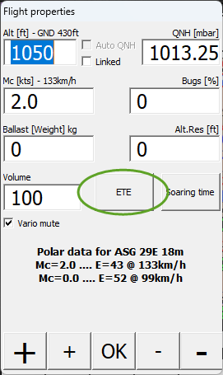
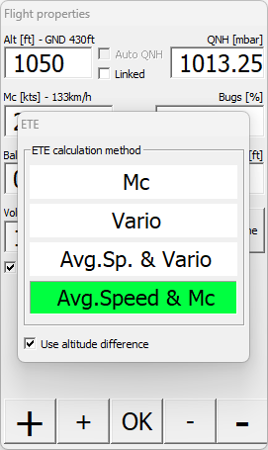
Prepare your Navigation
Set Task Delta as a Nav Box
  Estimated Time +Over/-Under
  Found in Settings/ Nav Boxes
Set up Calculation Method
  Mc: adjustable on instruments
  Speed: what has happened
  Vario: ??? Whatever
How to Use:
  Crank the Mc to adjust its estimated time of arrival
  Remember the FG impact!

Slide 18
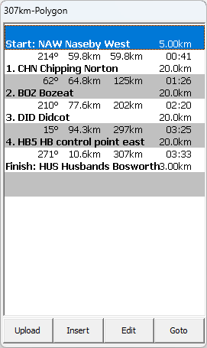
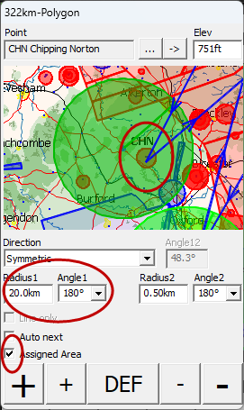
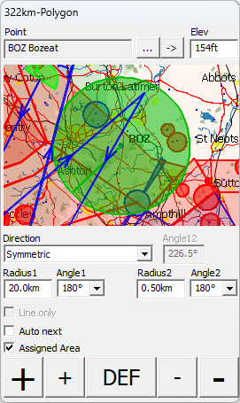
On the Ground: Task Setup

Slide 19
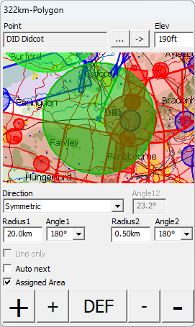
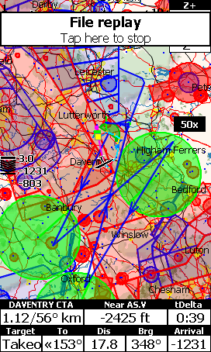
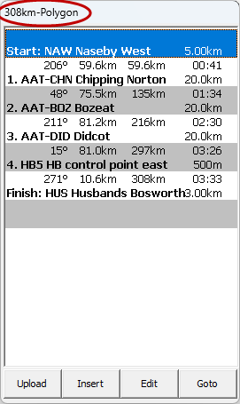
On the Ground- Continued

Slide 20
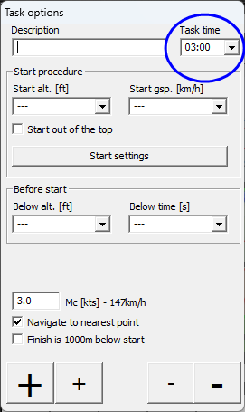
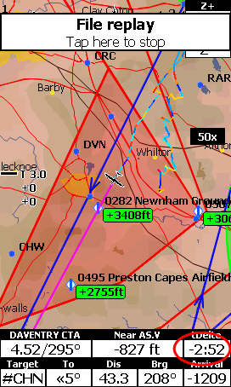
Monitoring Flying Time
Set the Flight Time and Delta
  Task: Options
  Set the Time
  Remember to Start
  Monitor tDelta

Slide 21
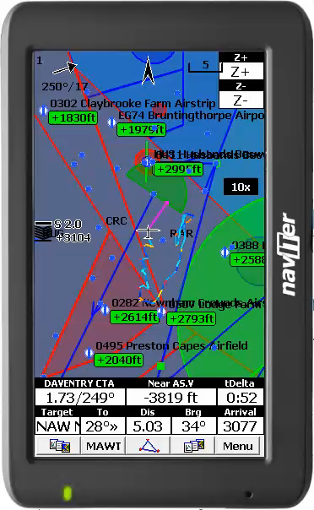
Golden Rule of
Instruments
You should touch them AS LITTLE AS POSSIBLE
  Confirm your Start
  GoTo Next Point
  Monitor tDelta
Often Happens
  Distraction to Soaring
  Confusing in the Air

Slide 22
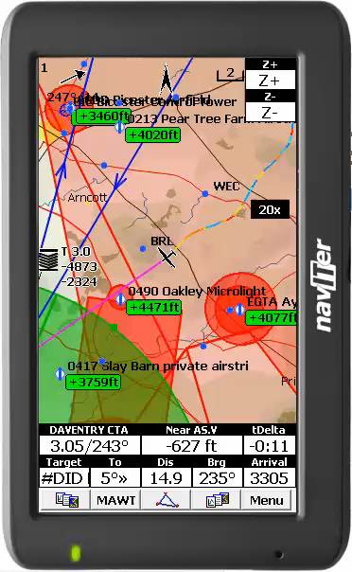
End Game
The Weather Came In
  Short in the 2nd sector
  Really worried I couldn’t get home
Selected Option
  Go Long in last sector
  Hope it recycles!

Slide 23
Managing Time and Distance
Plan your Task: Time and Distance
  Estimate your speed for the day
  Set mobile TPs so that you get the right distance
Set Up you Instruments
  Have a timer on your screen
  tDelta: Over/Under Time
  ETE: Av Sp & Vario (can use & Mc for quick adjustment)
  Aim to come in 5-10min over time (Final Glide effect)
Be flexible around the TPs set
  Follow the energy rather than line to the turn
  Best outcome is to turn at the top of a climb
  If conditions improve/deteriorate, Adjust in flight, don’t fiddle

Slide 24
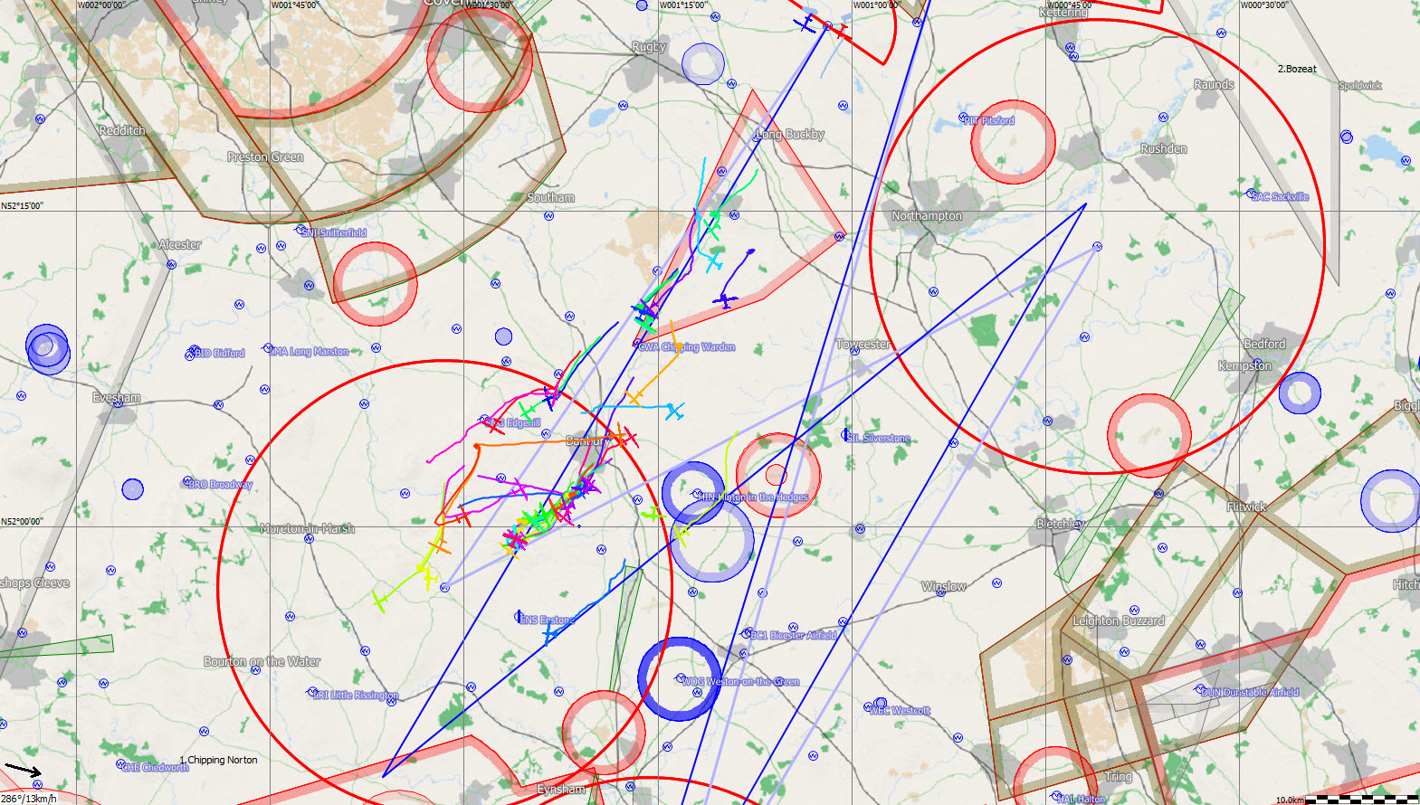
At the start: others turning on 2nd leg

Slide 25
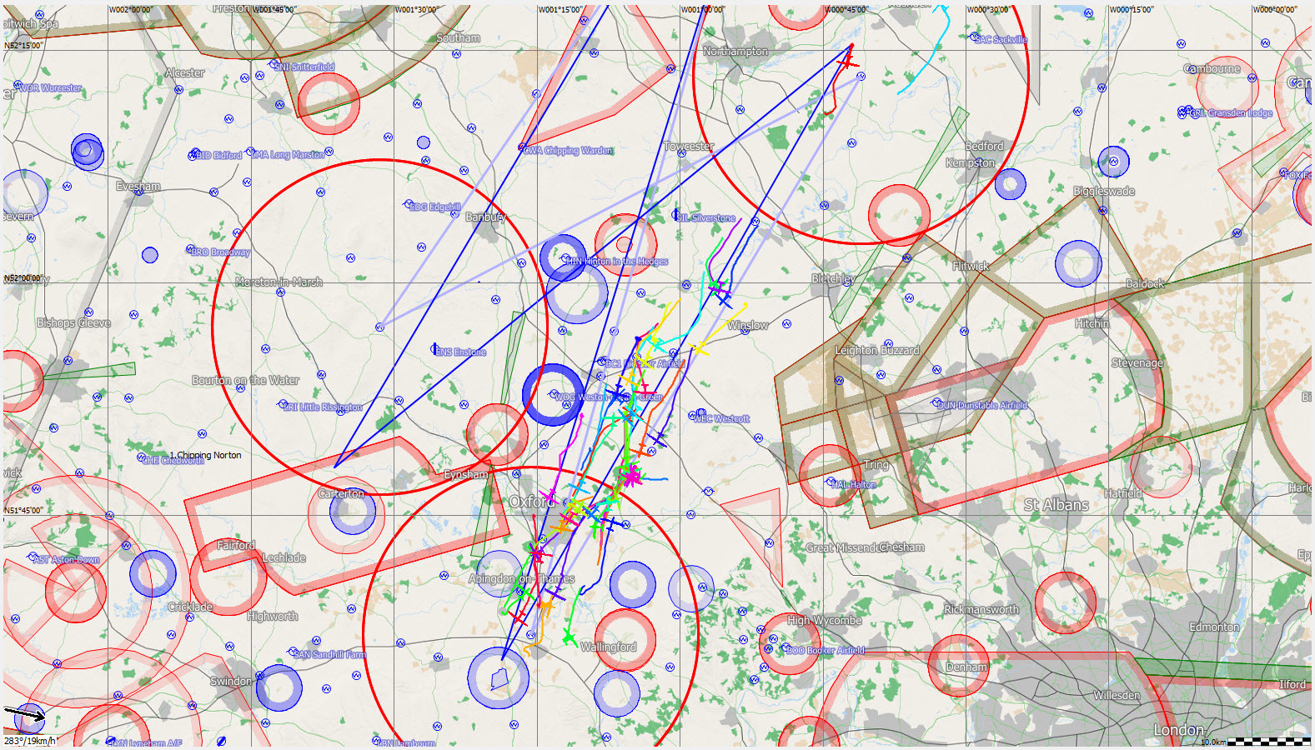
Decision Made: go for distance

Slide 26
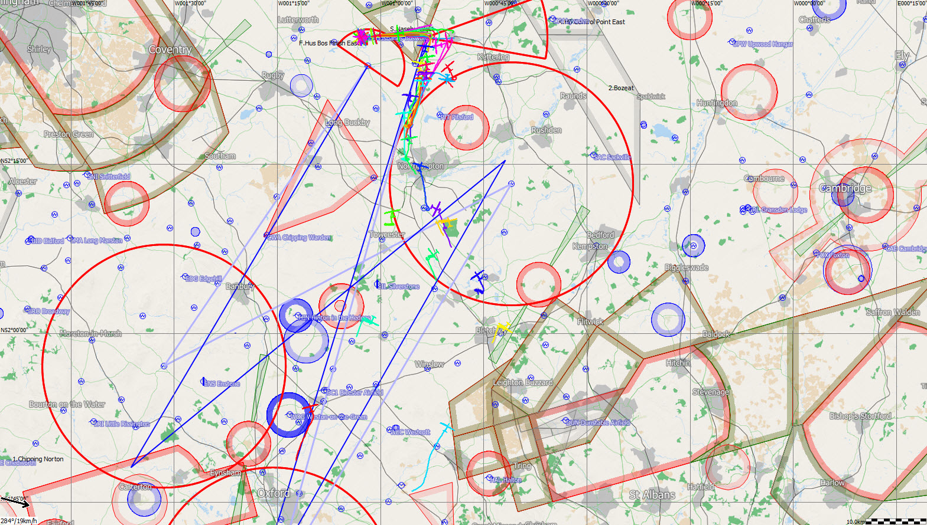
Realising you have a problem

Slide 27
Result: successful recovery
Questionable Start Decision
  Did have 2 poor initial runs out
  Was a high risk tactic with forecast deterioration
Very good running but writing was on the wall
  One run over 125Km, second leg at 148kph
  Positive decision to go for distance
End result:
  Last leg was slow, but GOT BACK
  3rd on the day: fast enough in the 1st half
  A very satisfying flight ☺

Slide 28
Nitra 2009, Day 4
Weather didn’t live up to the task
  Large area set but fell back twice on time
  Thunder development and overcast from the NW
Task Features:
  First leg into the flat lands, soggy ground, good air
  Second large area over mountains, largely unlandable
  Final area expected to be problematic with a front
Comp Situation:
  Very little practice in the Nimbus 4- not flying well
  With Pete H and Steve J were flying welded together
  Try for one last time to be the 3rd wheel…

Slide 29
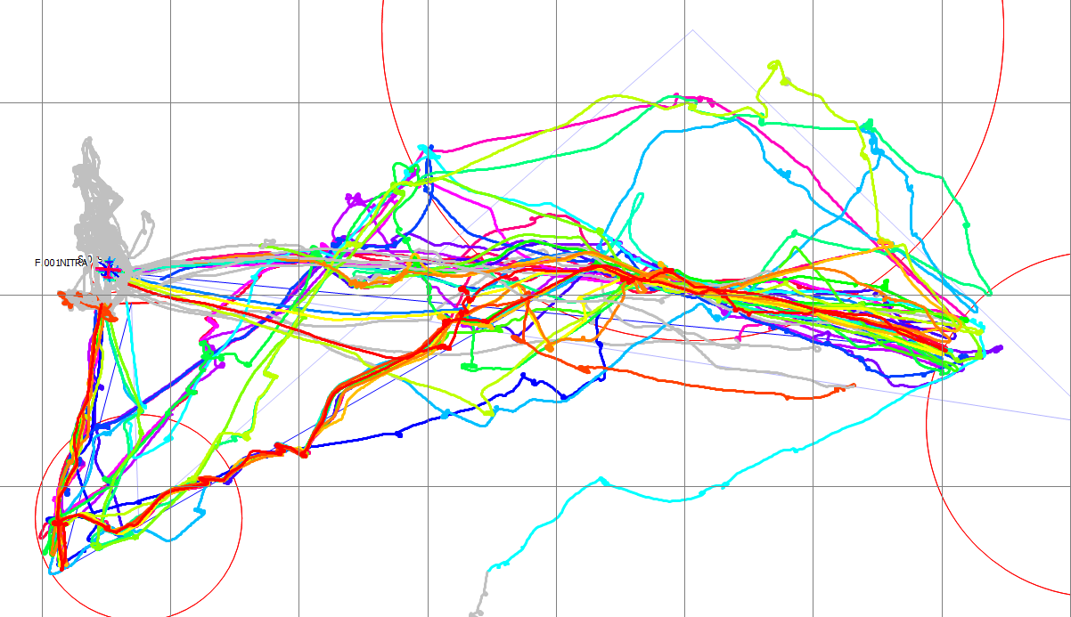
Task Overview

Slide 30
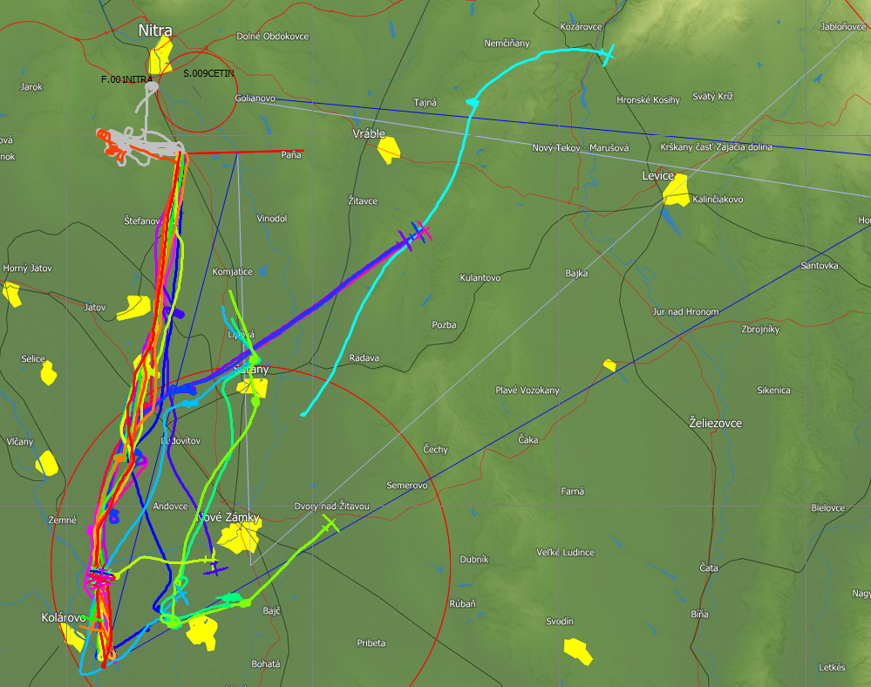
With the pack, Some early starters

Slide 31
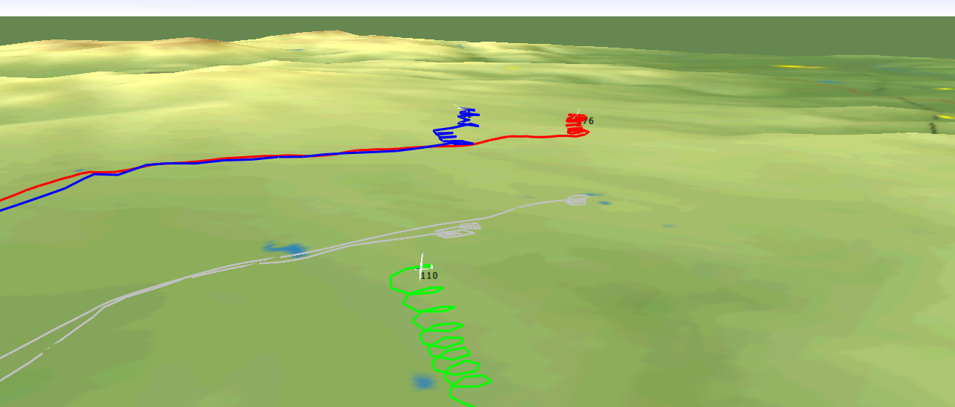
Winners went north

Slide 32
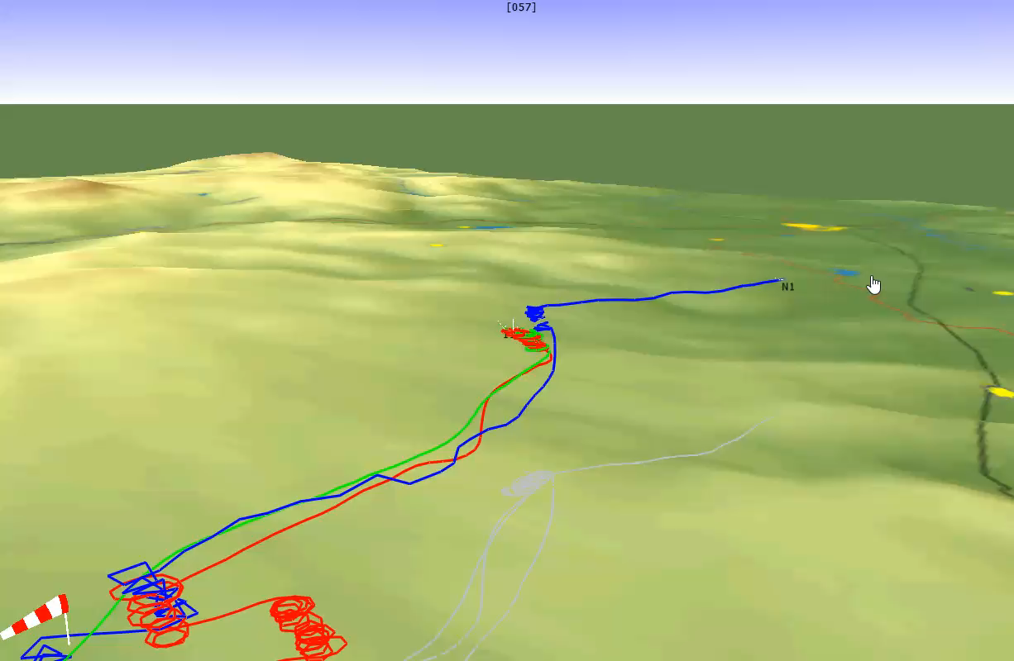
Then 60Km in and out… Bugwipers!

Slide 33
Result:
Started with the pack and went well as a team
  Winner did start early and went North
  Other early starters did not finish
Did not feed the post box!
  Used the 60:1 to get in and out cleanly
  But I always fell away in the long glides
  Got unlucky with the bugwipers! Grrr
Optimum Decisions
  Got it spot on: low risk, high reward
  Pete & Steve in top 4, I got back improved over-all
Turning point for me to finishing 5th over all

Slide 34
Recap: What to Do
Practice Setting Up
  Set up a few AATs in your instruments before the comp
Golden Rule is get back (fast if possible)
  AAT are speed tasks round a variable course
Enjoy the Flexibility to get best from the weather
  Follow the streets and climbs, take bigger diversions
  Use initial plan as guidance in flight
  If it is going well, keep going (within reason)
Focus on the Weather, not Instruments or the Time
  More important to keep the speed up than perfect time
  Ideally be on final climb or glide as time runs out

Slide 35
H:\Gliding\Traces Comps\2007 Opens\Day3
H:\Gliding\Traces Comps\2012 WGC\15m\Day 12 15m
H:\Gliding\Traces Comps\2007 18m\779
H:\Gliding\Traces Comps\2009 Nitra\Open\Open Day 4
H:\Gliding\Traces Comps\2001 WGC\New folder

